Slide 1


SMART INDIA HACKATHON 2024
TITLE PAGE
Problem Statement ID – 1630
Problem Statement Title- Mentor Connect
Theme - Smart Education
PS Category- Software
Team ID – IT03
Team Name – UNFAZED DYNAMOS

Slide 2
MENTOR CONNECT
UNFAZED
DYNAMOS
IDEA PROPOSED :
To create a platform that provides guidance for the candidates
Creation of automated calendar booking system
Embedded video call and Chat Feature to directly interact with mentors and clarify their queries
User Friendly Interface for easy accessibility of the candidates and mentors
Resource library for learning materials which helps in upliftment of the mentors
Progress tracking of the mentees and providing task progress bar to ensure motivated growth
Providing Badges for the mentee based on their progress bar
Mentor will be provided with Certificates based on their mentee’s progress to ensure they are engaged with the platform and guide more candidates
UNIQUENESS AND INNOVATION :
Ensures personalized connections
An all-in-one platform integrating scheduling communication, and resources, and scalable architecture that supports a diverse user base
It is continuously improves through real time feedback and is designed to be future proof
Rating to mentors via providing certificates based on the count and progress of students they guide.

Slide 3
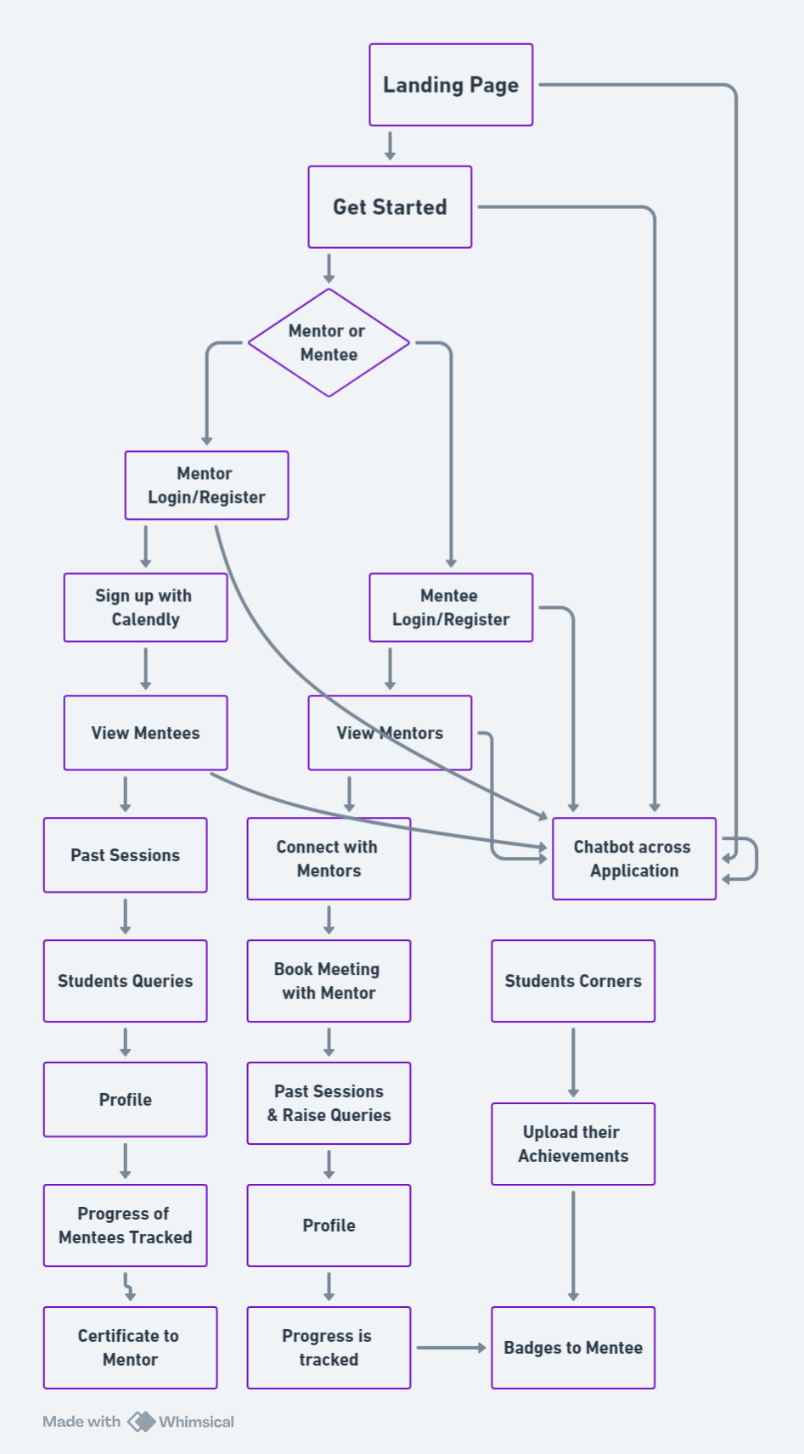
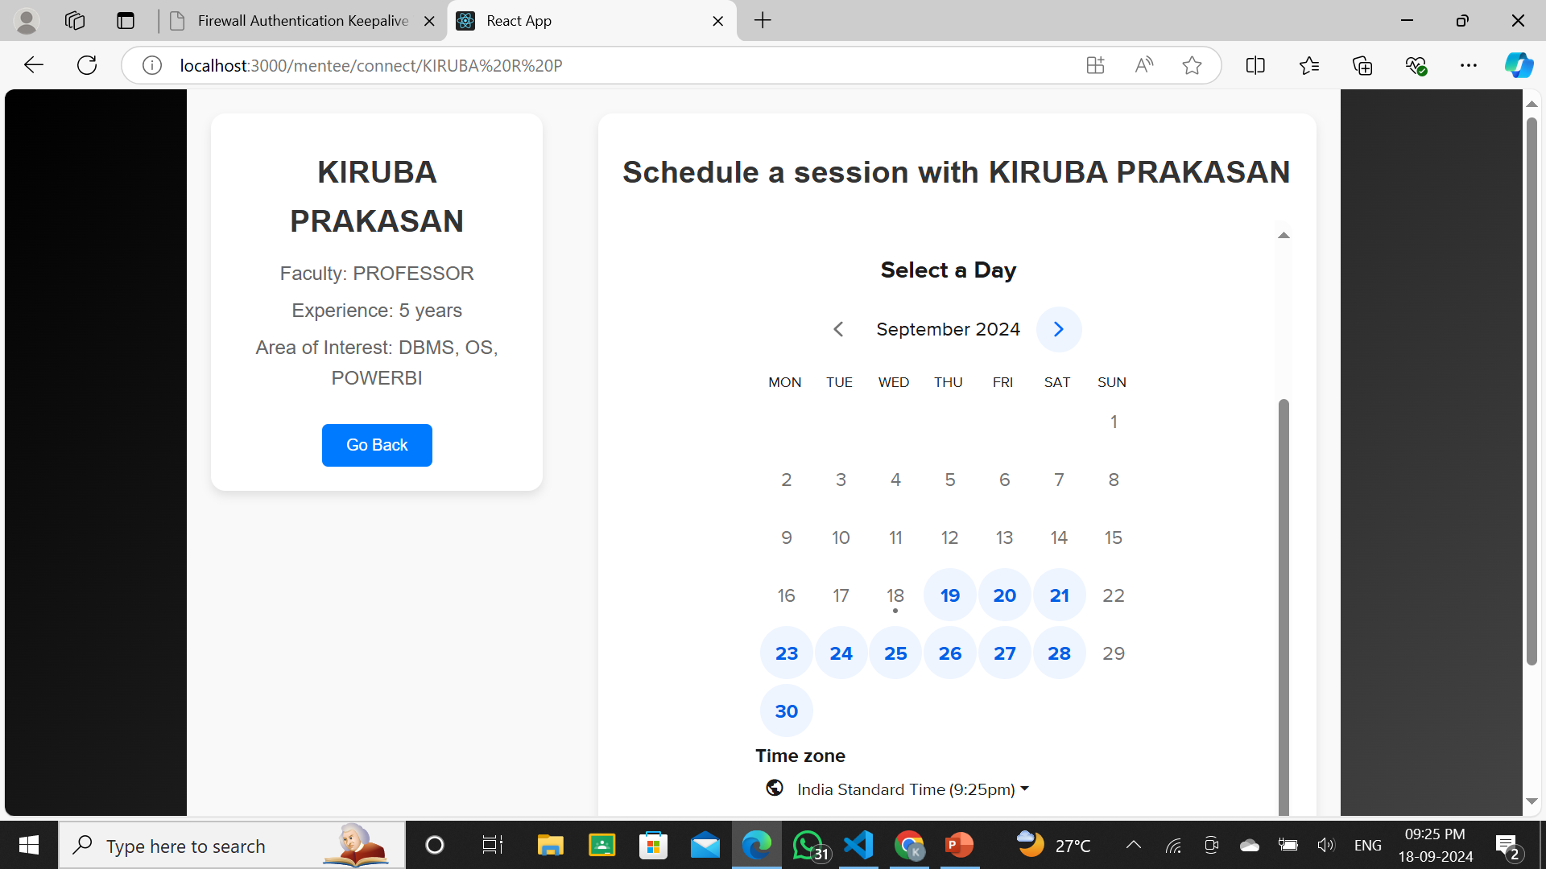


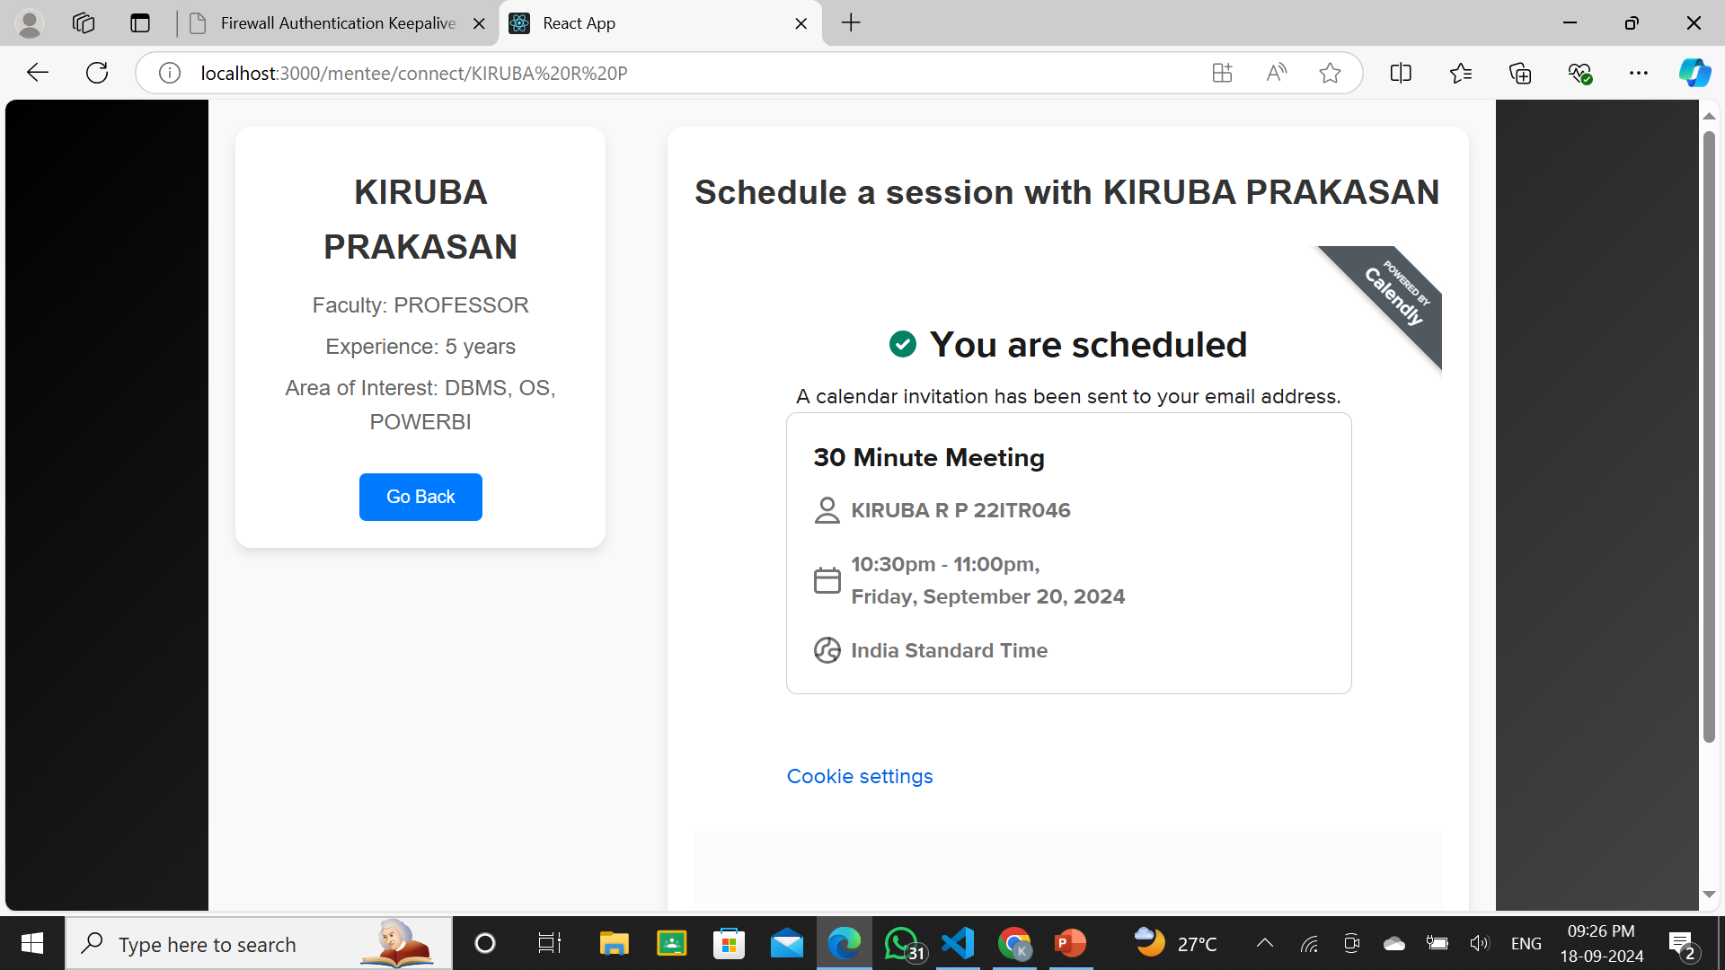

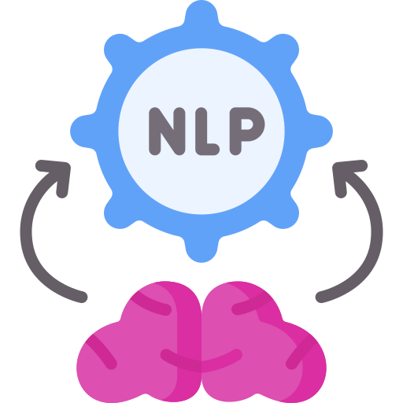
WORK FLOW & APPROACH
UNFAZED DYNAMOS
booking system <sample output>
TECHNICAL APPROACH
FRONTEND :
HTML
CSS
JS
REACT (FRAMEWORK)
BACKEND:
MONGODB
FIREBASE
API INTEGRATED :
CALENDLY
AI LOGIC:
NATURAL LANGUAGE PROCESSING FOR CHATBOT

Slide 4
FEASIBILITY AND VIABILITY
UNFAZED
DYNAMOS
FEASIBILITY :
Technical Feasibility: Use APIs for calendar integration and video calling; scalable cloud infrastructure.
Financial Feasibility: Moderate costs for development and maintenance; potential revenue through subscriptions and sponsorships.
Legal Feasibility: Ensure data privacy and compliance with regulations.
Market Feasibility: High demand for career mentoring; competition with LinkedIn and similar platforms.
POTENTIAL RISKS :
Technical: Complex calendar and video call integration; scalability as user base grows.
Financial: Sustaining platform costs and generating consistent revenue.
Operational: Ensuring mentor availability and high-quality interactions
Legal: Data security and privacy concerns.
Market: Breaking into a competitive market dominated by established platforms.
STATERGIES TO OVERCOME CHALLENGES :
Technical: Use established APIs and start with core features; scale with cloud infrastructure.
Financial: Implement premium models; seek grants, sponsorships, and corporate partnerships.
Operational: Partner with industries for mentor recruitment; implement feedback/rating system.
Legal: Prioritize data security and privacy with encryption and audits
Market: Host webinars, workshops, or career development events to engage users and build a community to attract both mentors and mentee

Slide 5
IMPACT AND BENEFITS
UNFAZED
DYNAMOS
POTENTIAL IMPACTS:
Career Growth: Provides students and professionals access to personalized guidance, improving career prospects.
Skill Development: Helps candidates develop industry-relevant skills through expert mentorship.
Networking Opportunities: Builds valuable connections between mentees and industry leaders.
Job Market Readiness: Prepares candidates for job market demands, increasing employability.
Access to Expertise: Democratizes access to knowledge and experience from mentors across industries.
BENEFITS:
Social Benefits: Promotes mentorship culture, bridges the skill gap, and fosters a more skilled workforce.
Economic Benefits: Enhances employment opportunities, leading to higher incomes and economic growth.
Educational Benefits: Supports continuous learning and development for both mentors and mentees.
Environmental Benefits: Virtual mentoring reduces the need for physical travel, lowering carbon emissions.
Inclusive Growth: Ensures that mentorship is accessible to candidates from diverse geographic and economic backgrounds.

Slide 6
RESEARCH AND REFERENCES
UNFAZED
DYNAMOS
RESEARCH AND REFERENCES:
RESEARCH PAPER:
https://shorturl.at/yS4at
REFERENCES :
https://tiecon.org/mentor-connect/

